Slide 1
File-System

Slide 2
File Concept
Contiguous logical address space
Types:
Data
numeric
character
binary
Program
Contents defined by file’s creator
Many types
Consider text file, source file, executable file
Notes:
<number>

Slide 3
File Attributes
Name – only information kept in human-readable form
Identifier – unique tag (number) identifies file within file system
Type – needed for systems that support different types
Location – pointer to file location on device
Size – current file size
Protection – controls who can do reading, writing, executing
Time, date, and user identification – data for protection, security, and usage monitoring
Information about files are kept in the directory structure, which is maintained on the disk
Many variations, including extended file attributes such as file checksum
Information kept in the directory structure
Notes:
<number>

Slide 4
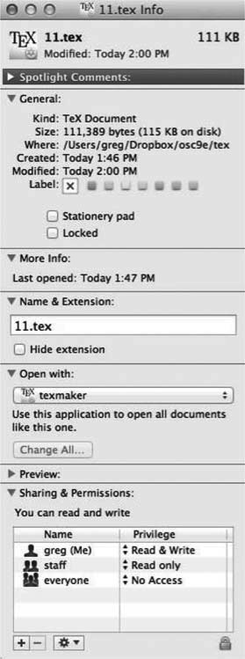
File info Window on Mac OS X
Notes:
<number>

Slide 5
File Operations
File is an abstract data type
Create
Write – at write pointer location
Read – at read pointer location
Reposition within file - seek
Delete
Truncate
Open(F_{i}) – search the directory structure on disk for entry F_{i}, and move the content of entry to memory
Close (F_{i}) – move the content of entry F_{i} in memory to directory structure on disk
Notes:
<number>

Slide 6
Open Files
Several pieces of data are needed to manage open files:
Open-file table: tracks open files
File pointer: pointer to last read/write location, per process that has the file open
File-open count: counter of number of times a file is open – to allow removal of data from open-file table when last processes closes it
Disk location of the file: cache of data access information
Access rights: per-process access mode information
Notes:
<number>

Slide 7
Open File Locking
Provided by some operating systems and file systems
Similar to reader-writer locks
Shared lock similar to reader lock – several processes can acquire concurrently
Exclusive lock similar to writer lock
Mediates access to a file
Mandatory or advisory:
Mandatory – access is denied depending on locks held and requested
Advisory – processes can find status of locks and decide what to do
Notes:
<number>

Slide 8
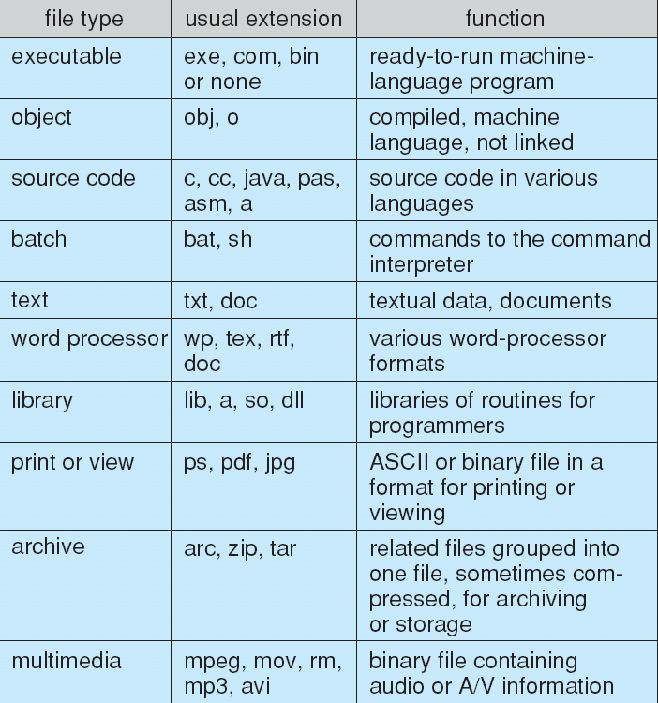
File Types – Name, Extension
Notes:
<number>

Slide 9
File Structure
None - sequence of words, bytes
Simple record structure
Lines
Fixed length
Variable length
Complex Structures
Formatted document
Relocatable load file
Can simulate last two with first method by inserting appropriate control characters
Who decides:
Operating system
Program
Notes:
<number>

Slide 10
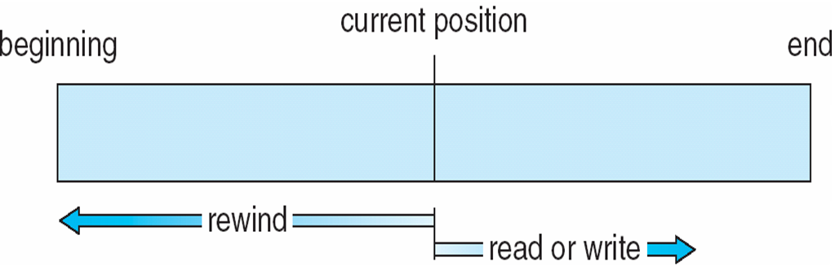
Sequential-access File
Notes:
<number>

Slide 11
Access Methods
Sequential Access
read next
write next
reset
no read after last write
(rewrite)
Direct Access – file is fixed length logical records
read n
write n
position to n
read next
write next
rewrite n
n = relative block number
Relative block numbers allow OS to decide where file should be placed
See allocation problem in Ch 11
Notes:
<number>

Slide 12
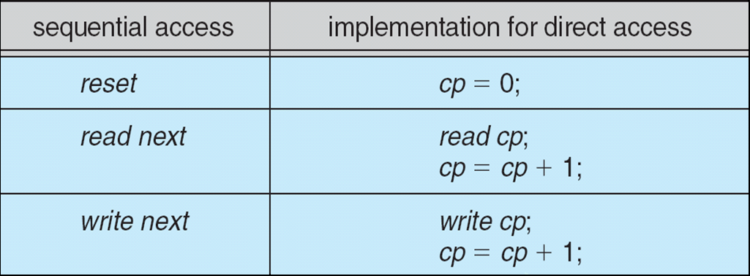
Simulation of Sequential Access on Direct-access File
Notes:
<number>

Slide 13
Other Access Methods
Can be built on top of base methods
General involve creation of an index for the file
Keep index in memory for fast determination of location of data to be operated on (consider UPC code plus record of data about that item)
If too large, index (in memory) of the index (on disk)
IBM indexed sequential-access method (ISAM)
Small master index, points to disk blocks of secondary index
File kept sorted on a defined key
All done by the OS
VMS operating system provides index and relative files as another example (see next slide)
Notes:
<number>

Slide 14
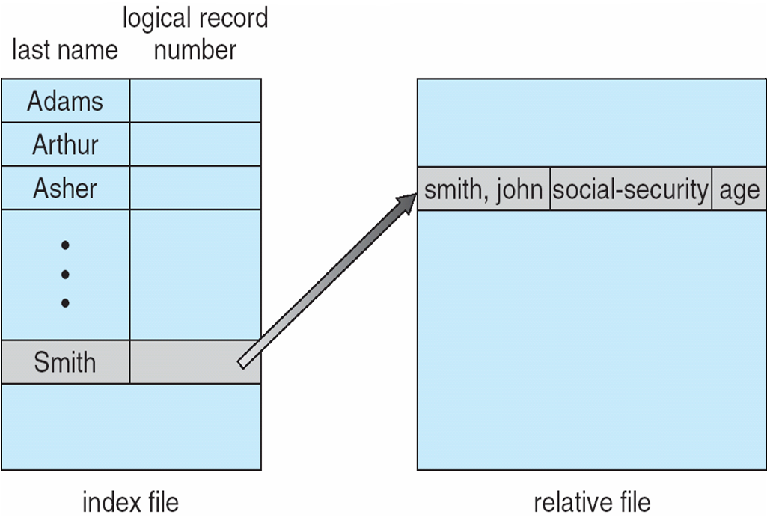
Example of Index and Relative Files
Notes:
<number>

Slide 15
Directory Structure
A collection of nodes containing information about all files
Directory
Files
F 1
F 2
F 3
F 4
F n
Both the directory structure and the files reside on disk
Notes:
<number>

Slide 16
Disk Structure
Disk can be subdivided into partitions
Disks or partitions can be RAID protected against failure
Disk or partition can be used raw – without a file system, or formatted with a file system
Partitions also known as minidisks, slices
Entity containing file system known as a volume
Each volume containing file system also tracks that file system’s info in device directory or volume table of contents
As well as general-purpose file systems there are many special-purpose file systems, frequently all within the same operating system or computer
Notes:
<number>

Slide 17
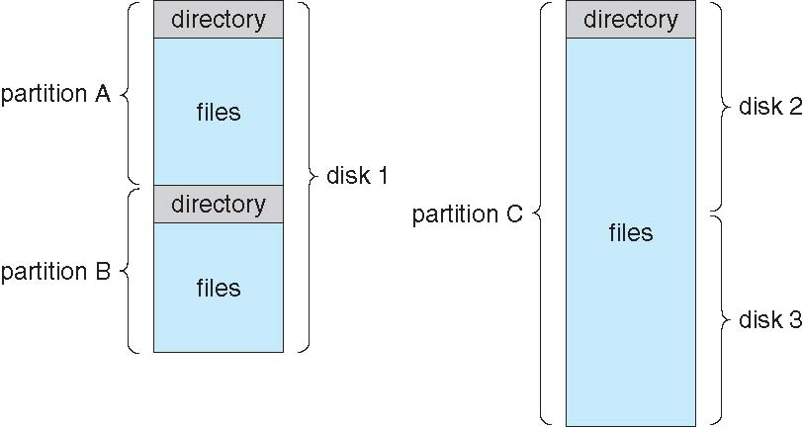
A Typical File-system Organization
Notes:
<number>

Slide 18
Types of File Systems
We mostly talk of general-purpose file systems
But systems frequently may have file systems, some general- and some special- purpose
Consider Solaris has
tmpfs – memory-based volatile FS for fast, temporary I/O
objfs – interface into kernel memory to get kernel symbols for debugging
ctfs – contract file system for managing daemons
lofs – loopback file system allows one FS to be accessed in place of another
procfs – kernel interface to process structures
ufs, zfs – general purpose file systems
Notes:
<number>

Slide 19
File-System Structure
File structure
Logical storage unit
Collection of related information
File system resides on secondary storage (disks)
Provide user interface to storage, mapping logical file system to physical storage devices
Provides efficient and convenient access to disk by allowing data to be stored, located retrieved easily
Disk provides in-place rewrite and random access
I/O transfers performed in blocks of sectors (usually 512 bytes)
Notes:
<number>

Slide 20
File-System Structure
File control block – storage structure consisting of information about a file
Device driver controls the physical device
File system organized into layers or levels

Slide 21
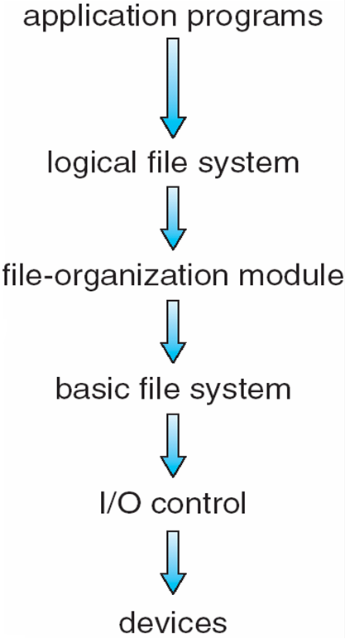
Layered File System
Notes:
<number>

Slide 22
File System Layers
I/O Control Level consists of device drivers and interrupt handlers to transfer information between the main memory and the disk system.
Device drivers manage I/O devices at the I/O control layer
A device driver can be thought of as a translator.
Given input commands like “read drive1, cylinder 72, track 2, sector 10, into memory location 1060” outputs low-level hardware specific commands to hardware controller
Basic file system issues generic commands to the appropriate device driver to read and write physical blocks on the disk.
Also manages memory buffers and caches (allocation, freeing, replacement)

Slide 23
File System Layers
File organization module understands files, logical address, and physical blocks
Translates logical block # to physical block #
Manages free space, disk allocation that tracks unallocated blocks and provides these blocks to the file-organization module when requested.

Slide 24
File System Layers (Cont.)
Logical file system manages metadata information
Translates file name into file number, file handle, location by maintaining file control blocks (inodes in UNIX)
FCB contains information about the file, including ownership, permissions, and location of the file contents
Directory management
Protection
Layering useful for reducing complexity and redundancy, but adds overhead and can decrease performance
Logical layers can be implemented by any coding method

Slide 25
File System Layers (Cont.)
Many file systems, sometimes many within an operating system
Each with its own format (CD-ROM is ISO 9660; Unix has UFS, FFS; Windows has FAT, FAT32, NTFS as well as floppy, CD, USB, Linux has more than 40 types, with extended file system ext2 and ext3, ReiserFS; plus distributed file systems, etc.)
New ones still arriving – ZFS, GoogleFS, Oracle ASM, FUSE

Slide 26
File-System Implementation
We have system calls at the API level, but how do we implement their functions?
On-disk and in-memory structures
Boot control block contains information needed by system to boot OS from that volume
Needed if volume contains OS, usually first block of volume
Volume control block contains volume details
such as the number of blocks in the partition, the size of the blocks, a free-block count and free-block pointers, and a free-FCB count and FCB pointers.
In Unix, this is called a superblock
Directory structure per file system organizes the files
Names and inode numbers, master file table

Slide 27
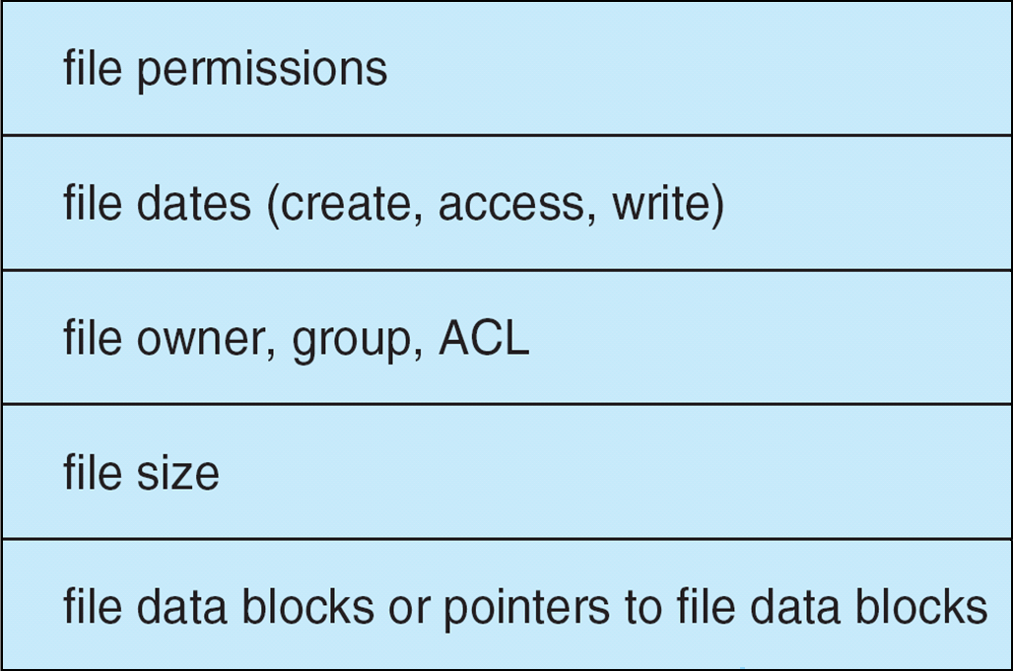
File-System Implementation (Cont.)
Per-file File Control Block (FCB) contains many details about the file
inode number, permissions, size, dates
May store file information into in master file table using relational DB structures

Slide 28
File Implementation
Files stored on disks.
Disks broken up into one or more partitions, with separate file system (fs) on each partition
Sector 0 of disk is the Master Boot Record
Is used to boot the computer
End of MBR has partition table.
Has starting and ending addresses of each partition.
One of the partitions is marked active in the master boot table
Tanenbaum, Modern Operating Systems 3 e, (c) 2008 Prentice-Hall, Inc. All rights reserved. 0-13-6006639

Slide 29
File Implementation
Boot computer => BIOS reads/executes MBR
MBR finds active partition and reads in first block (boot block)
Program in boot block locates the OS for that partition and reads it in
All partitions start with a boot block
Tanenbaum, Modern Operating Systems 3 e, (c) 2008 Prentice-Hall, Inc. All rights reserved. 0-13-6006639

Slide 30
A Possible File System Layout
Tanenbaum, Modern Operating Systems 3 e, (c) 2008 Prentice-Hall, Inc. All rights reserved. 0-13-6006639

Slide 31
File System Layout
Superblock contains info about the fs (e.g. type of fs, number of blocks, …)
i-nodes contain info about files
Tanenbaum, Modern Operating Systems 3 e, (c) 2008 Prentice-Hall, Inc. All rights reserved. 0-13-6006639

Slide 32
Structures for file system operations
An in-memory mount table contains information about each mounted volume.
An in-memory directory-structure cache holds the directory information of recently accessed directories.
For directories at which volumes are mounted, it can contain a pointer to the volume table.
System-wide open-file table contains a copy of the FCB of each open file, as well as other information.
Per-process open-file table contains a pointer to the appropriate entry in the system-wide open-file table, as well as other information.
Buffers hold file-system blocks when they are being read from disk or written to disk.

Slide 33
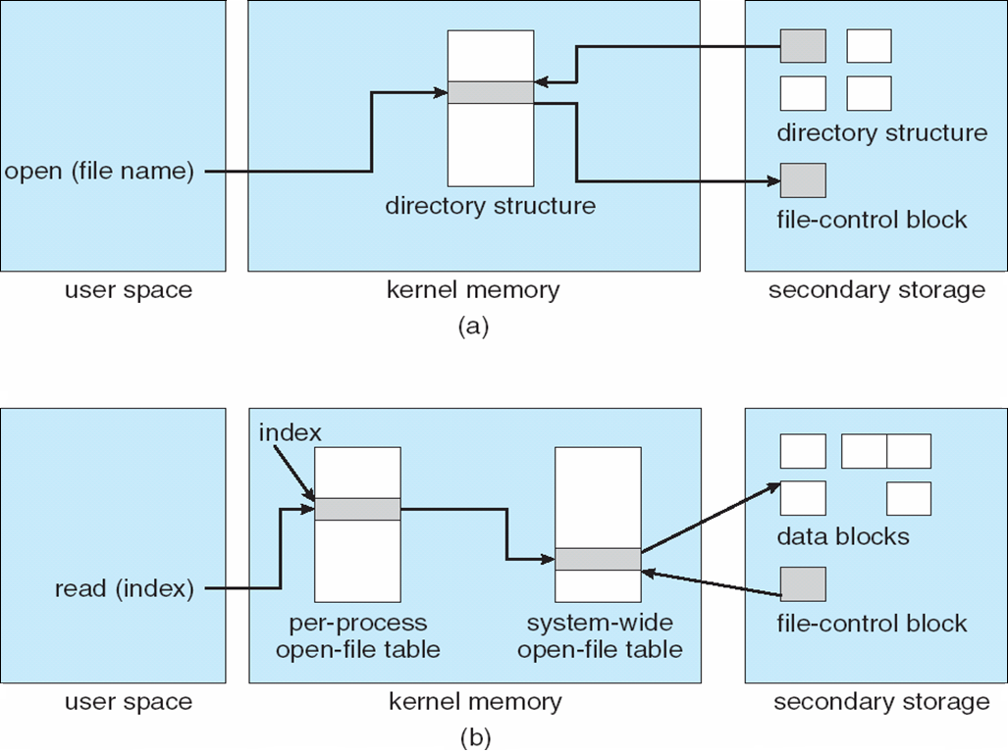
In-Memory File System Structures
Notes:
<number>

Slide 34
In-Memory File System Structures
When a process closes the file, the per-process table entry is removed, and the system-wide entry’s open count is decremented.
When all users that have opened the file close it, any updated metadata is copied back to the disk-based directory structure, and the system-wide open-file table entry is removed.
System-wide open-file table may also holds similar information for network connections and devices.
In this way, one mechanism can be used for multiple purposes.

Slide 35
Partitions and Mounting
Partition can be a volume containing a file system (“cooked”) or raw – just a sequence of blocks with no file system
Boot block can point to boot volume or boot loader set of blocks that contain enough code to know how to load the kernel from the file system
Or a boot management program for multi-os booting
Root partition contains the OS, other partitions can hold other OSs, other file systems, or be raw
Mounted at boot time
Other partitions can mount automatically or manually
At mount time, file system consistency checked
Is all metadata correct?
If not, fix it, try again
If yes, add to mount table, allow access

Slide 36
Virtual File Systems
Virtual File Systems (VFS) on Unix provide an object-oriented way of implementing file systems
VFS allows the same system call interface (the API) to be used for different types of file systems
Separates file-system generic operations from implementation details
Implementation can be one of many file systems types, or network file system
Implements vnodes which hold inodes or network file details
Then dispatches operation to appropriate file system implementation routines
Notes:
<number>

Slide 37
Virtual File Systems (1)
Have multiple fs on same machine
Windows specifies fs (drives)
Unix integrates into VFS
VFS calls from user
Lower calls to actual fs
Supports Network File System-file can be on a remote machine
Tanenbaum, Modern Operating Systems 3 e, (c) 2008 Prentice-Hall, Inc. All rights reserved. 0-13-6006639

Slide 38
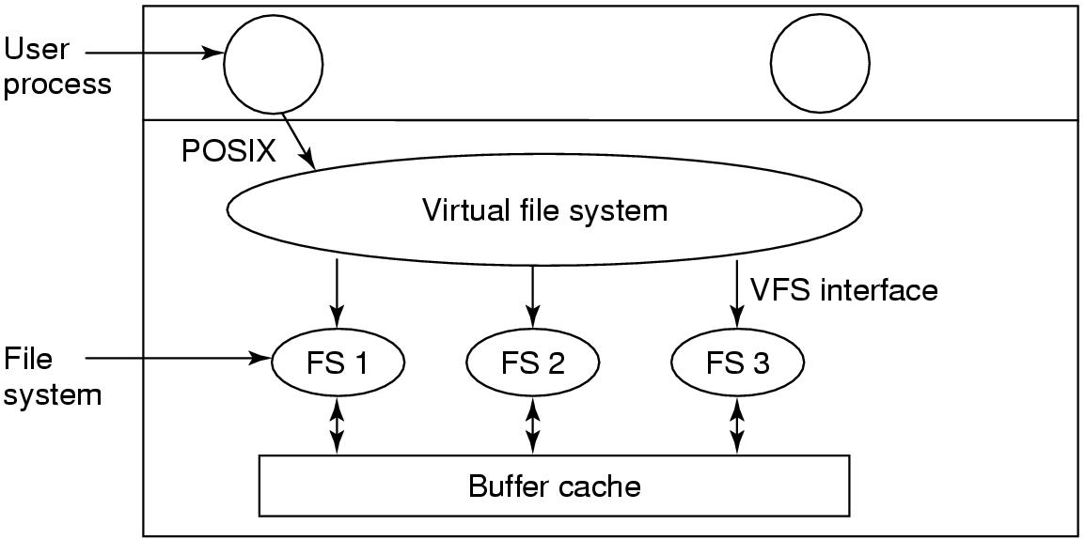
Virtual File Systems (2)
Tanenbaum, Modern Operating Systems 3 e, (c) 2008 Prentice-Hall, Inc. All rights reserved. 0-13-6006639

Slide 39
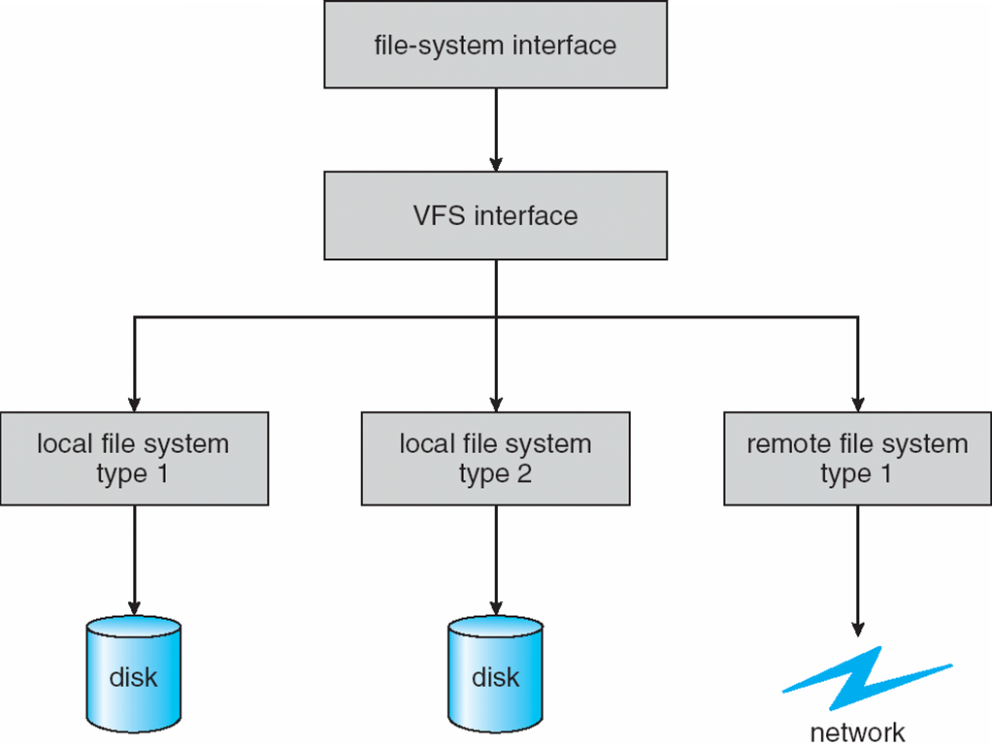
Virtual File Systems (Cont.)
The API is to the VFS interface, rather than any specific type of file system
Notes:
<number>

Slide 40
VFS Implementation
For example, Linux has four object types:
inode, file (open file), superblock (entire fs), dentry
For each of these four objects, VFS defines set of operations on the objects that must be implemented
Every object has a pointer to a function table
Function table has addresses of routines to implement that function on that object
For example:
int open(. . .)—Open a file
int close(. . .)—Close an already-open file
ssize t read(. . .)—Read from a file
ssize t write(. . .)—Write to a file
int mmap(. . .)—Memory-map a file

Slide 41
File System Mounting
A file system must be mounted before it can be accessed
A unmounted file system is mounted at a mount point
Notes:
<number>

Slide 42
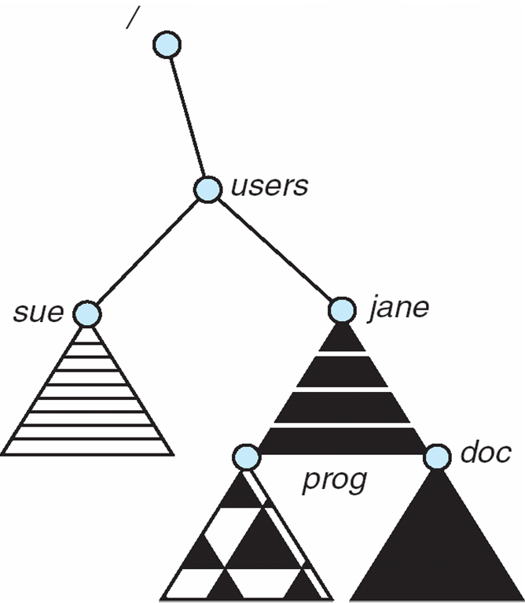
Mount Point
Notes:
<number>

Slide 43
File Sharing – Failure Modes
All file systems have failure modes
For example corruption of directory structures or other non-user data, called metadata
Remote file systems add new failure modes, due to network failure, server failure
Recovery from failure can involve state information about status of each remote request
Stateless protocols such as NFS v3 include all information in each request, allowing easy recovery but less security
Notes:
<number>

Slide 44
Open Files
Several pieces of data are needed to manage open files:
Open-file table: tracks open files
File pointer: pointer to last read/write location, per process that has the file open
File-open count: counter of number of times a file is open – to allow removal of data from open-file table when last processes closes it
Disk location of the file: cache of data access information
Access rights: per-process access mode information
Notes:
<number>

Slide 45
Open File Locking
Provided by some operating systems and file systems
Similar to reader-writer locks
Shared lock similar to reader lock – several processes can acquire concurrently
Exclusive lock similar to writer lock
Mediates access to a file
Mandatory or advisory:
Mandatory – access is denied depending on locks held and requested
Advisory – processes can find status of locks and decide what to do
Notes:
<number>

Slide 46
File Structure
None
Simple record structure
Lines
Fixed length
Variable length
Complex Structures
Formatted document
Relocatable load file
Who decides:
Operating system
Program
Notes:
<number>

Slide 47
Allocation Methods - Contiguous
An allocation method refers to how disk blocks are allocated for files:
Contiguous allocation – each file occupies set of contiguous blocks
Best performance in most cases
Simple – only starting location (block #) and length (number of blocks) are required
Problems include finding space for file, knowing file size, external fragmentation, need for compaction off-line (downtime) or on-line
Notes:
<number>

Slide 48
Sequential-access File
Notes:
<number>

Slide 49
Access Methods
Sequential Access
read next
write next
reset
no read after last write
(rewrite)
Direct Access – file is fixed length logical records
read n
write n
position to n
read next
write next
rewrite n
n = relative block number
Relative block numbers allow OS to decide where file should be placed
Notes:
<number>

Slide 50
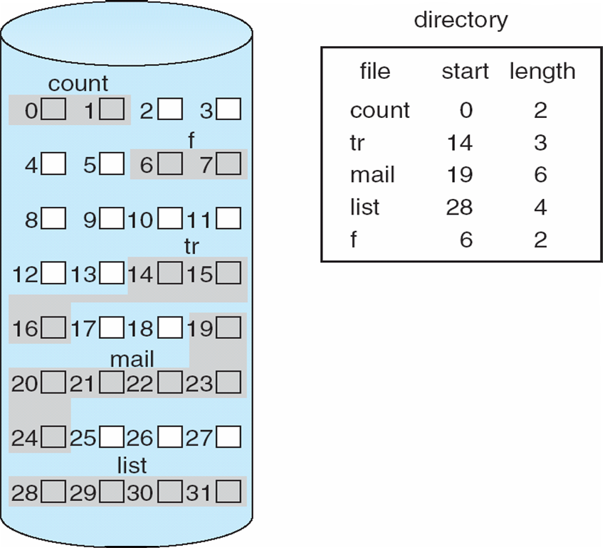
Contiguous Allocation of Disk Space
Notes:
<number>

Slide 51
Extent-Based Systems
Many newer file systems (i.e., Veritas File System) use a modified contiguous allocation scheme
Extent-based file systems allocate disk blocks in extents
An extent is a contiguous block of disks
Extents are allocated for file allocation
A file consists of one or more extents
Notes:
<number>

Slide 52
Allocation Methods - Linked
Linked allocation – each file a linked list of blocks
File ends at nil pointer
No external fragmentation
Each block contains pointer to next block
No compaction, external fragmentation
Free space management system called when new block needed
Improve efficiency by clustering blocks into groups but increases internal fragmentation
Reliability can be a problem
Locating a block can take many I/Os and disk seeks
FAT (File Allocation Table) variation
Beginning of volume has table, indexed by block number
Much like a linked list, but faster on disk and cacheable
New block allocation simple

Slide 53
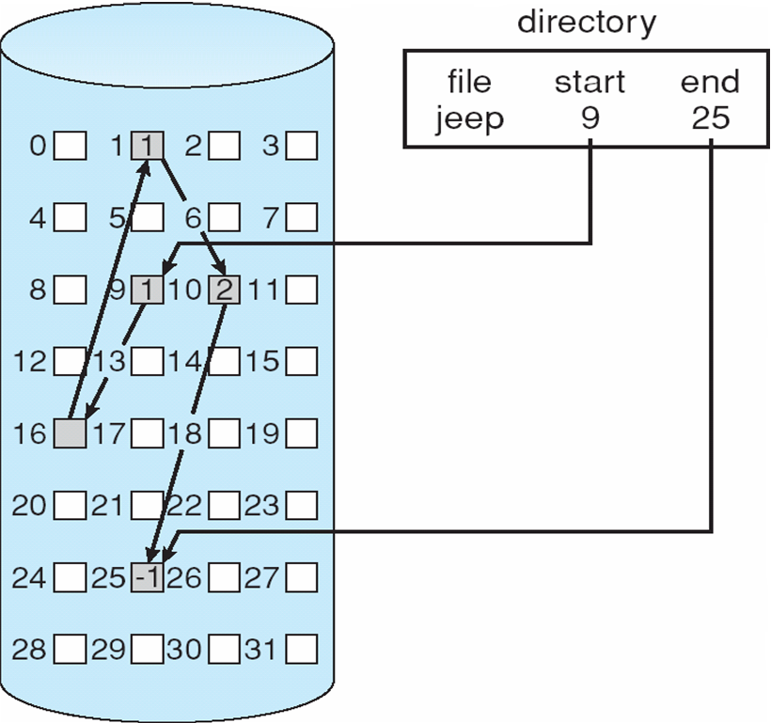
Linked Allocation
Notes:
<number>

Slide 54
Allocation Methods - Indexed
Indexed allocation
Each file has its own index block(s) of pointers to its data blocks
Logical view
index table

Slide 55
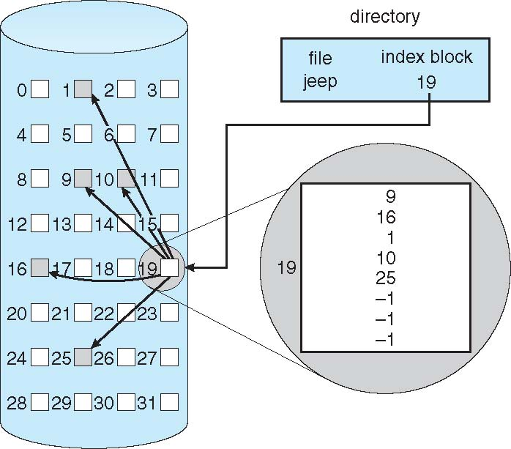
Example of Indexed Allocation
Notes:
<number>

Slide 56
Indexed Allocation (Cont.)
Need index table
Random access
Dynamic access without external fragmentation, but have overhead of index block
Mapping from logical to physical in a file of maximum size of 256K bytes and block size of 512 bytes.
We need only 1 block for index table
Notes:
<number>

Slide 57
Multilevel Index
A variant of linked representation
Uses a first-level index block to point to a set of second-level index blocks, which in turn point to the file blocks.
To access a block, the operating system uses the first-level index to find a second-level index block and then uses that block to find the desired data block.
Approach could be continued to a third or fourth level, depending on the desired maximum file size.
With 4,096-byte blocks, we could store 1,024 four-byte pointers in an index block.
Two levels of indexes allow 1,048,576 data blocks and a file size of up to 4 GB.

Slide 58
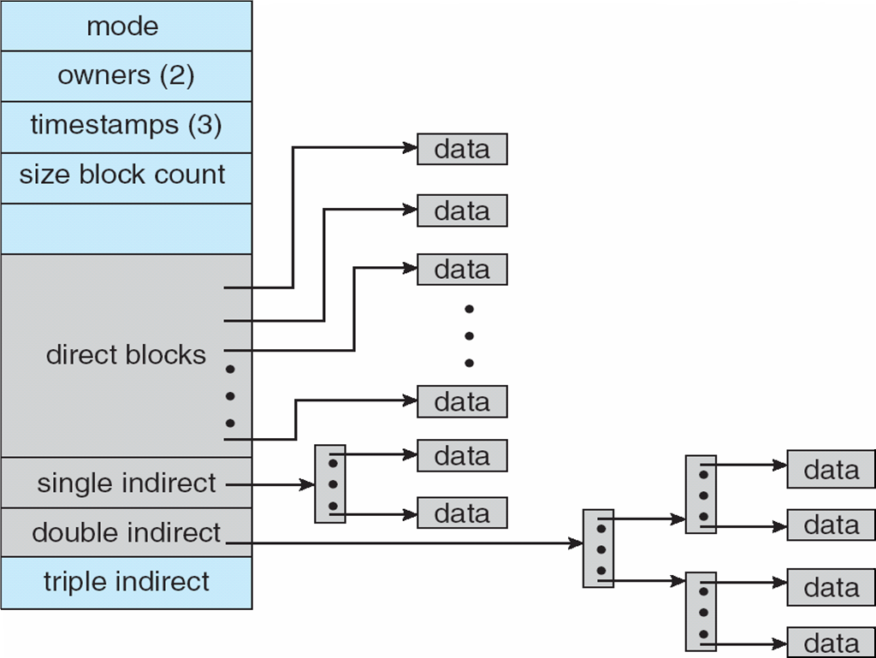
Combined Scheme: UNIX UFS (4K bytes per block, 32-bit addresses)
Note: More index blocks than can be addressed with 32-bit file pointer
Unix Inode
Notes:
<number>

Slide 59
Directory Implementation
Linear list of file names with pointer to the data blocks
Simple to program
Time-consuming to execute
Linear search time
Could keep ordered alphabetically via linked list or use B+ tree
Hash Table – linear list with hash data structure
Decreases directory search time
Collisions – situations where two file names hash to the same location
Only good if entries are fixed size, or use chained-overflow method
Notes:
<number>

Slide 60
Operations Performed on Directory
Search for a file
Create a file
Delete a file
List a directory
Rename a file
Traverse the file system
Notes:
<number>

Slide 61
Organize the Directory (Logically) to Obtain
Efficiency – locating a file quickly
Naming – convenient to users
Two users can have same name for different files
The same file can have several different names
Grouping – logical grouping of files by properties, (e.g., all Java programs, all games, …)
Notes:
<number>

Slide 62
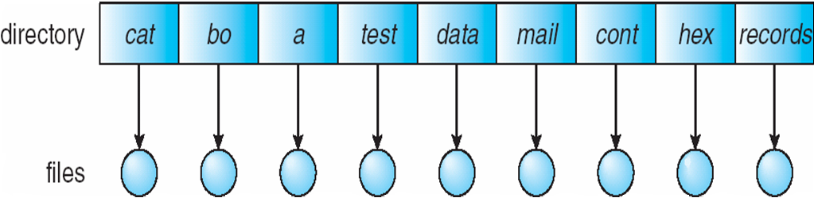
Single-Level Directory
A single directory for all users
Naming problem
Grouping problem
Notes:
<number>

Slide 63
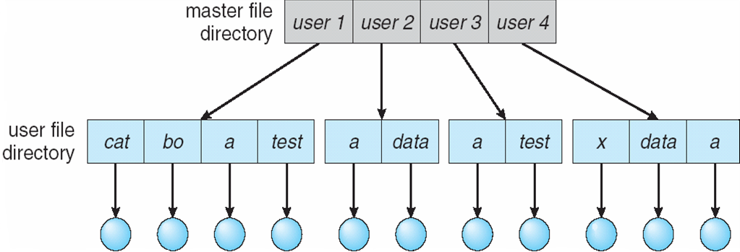
Two-Level Directory
Separate directory for each user
Path name
Can have the same file name for different user
Efficient searching
No grouping capability
Notes:
<number>

Slide 64
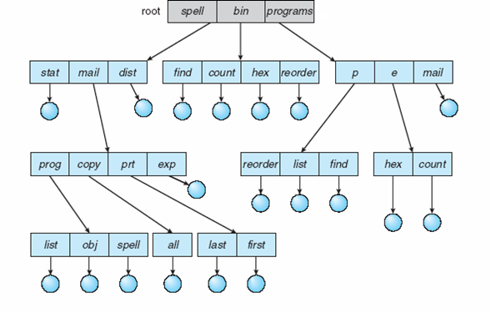
Tree-Structured Directories
Notes:
<number>

Slide 65
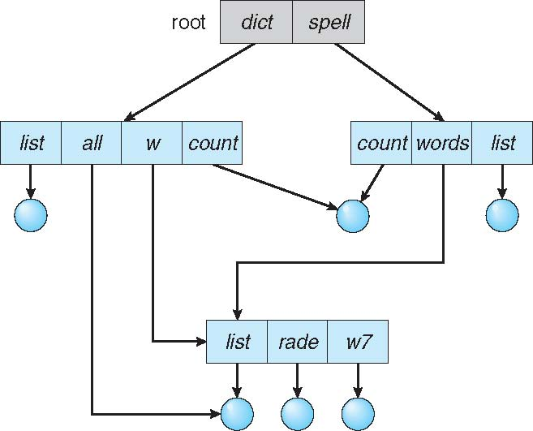
Acyclic-Graph Directories
Have shared subdirectories and files
Notes:
<number>

Slide 66
Acyclic-Graph Directories (Cont.)
Two different names (aliasing)
If dict deletes list ⇒ dangling pointer
Solutions:
Backpointers, so we can delete all pointers Variable size records a problem
Backpointers using a daisy chain organization
Entry-hold-count solution
New directory entry type
Link – another name (pointer) to an existing file
Resolve the link – follow pointer to locate the file
Notes:
<number>

Slide 67
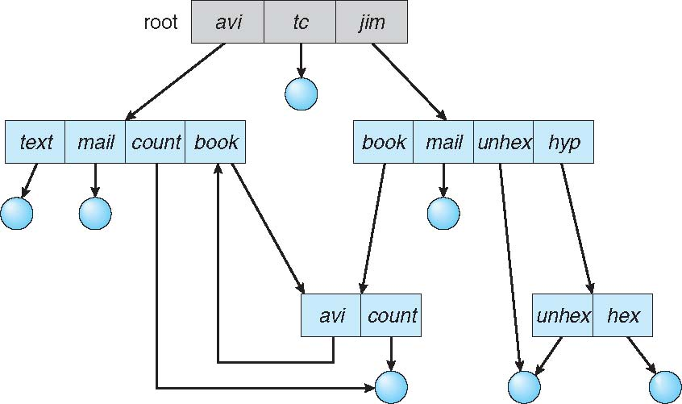
General Graph Directory
Notes:
<number>

Slide 68
General Graph Directory (Cont.)
How do we guarantee no cycles?
Allow only links to file not subdirectories
Garbage collection
Every time a new link is added use a cycle detection algorithm to determine whether it is OK
Notes:
<number>

Slide 69
Free-Space Management
To keep track of free disk space, the system maintains a free-space list.
The free-space list records all free device blocks—those not allocated to some file or directory.
To create a file, we search the free-space list for the required amount of space and allocate

Slide 70
Bit Vector Scheme
Implemented as a bitmap or bit vector.
Each block is represented by 1 bit.
If the block is free, the bit is 1; if the block is allocated, the bit is 0.
For example, consider a disk where blocks 2, 3, 4, 5, 8, 9, 10, 11, 12, 13, 17, 18, 25, 26, and 27 are free and the rest of the blocks are allocated.
The free-space bitmap would be 001111001111110001100000011100000 ...

Slide 71
Bit Vector Scheme
Main advantage of this approach is its relative simplicity and its efficiency in finding the first free block or n consecutive free blocks on the disk.
CPU may have supply bit-manipulation instructions that can be used effectively for that purpose.
For finding the first free block on a system sequentially check each word in the bitmap to see whether that value is not 0, since a 0-valued word contains only 0 bits and represents a set of allocated blocks.
The first non-0 word is scanned for the first 1 bit, which is the location of the first free block.

Slide 72
Bit Vector Scheme
Bit vector or bit map (n blocks)
Block number = (number of bits per word) x (number of 0-value words) + offset of first 1 bit
CPUs have instructions to return offset within word of first “1” bit
Notes:
<number>

Slide 73
Free-Space Management (Cont.)
Bit map requires extra space
Easy to get contiguous files
Notes:
<number>

Slide 74
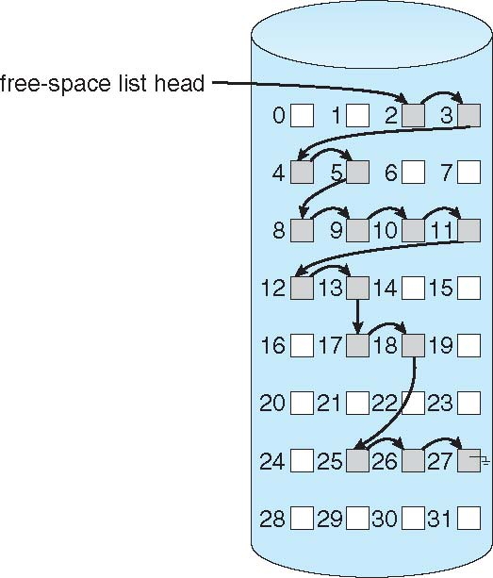
Linked Free Space List on Disk
Linked list (free list)
Cannot get contiguous space easily
No waste of space
No need to traverse the entire list (if # free blocks recorded)
Notes:
<number>

Slide 75
Free-Space Management (Cont.)
Grouping
Modify linked list to store address of next n-1 free blocks in first free block, plus a pointer to next block that contains free-block-pointers (like this one)
Counting
Because space is frequently contiguously used and freed, with contiguous-allocation allocation, extents, or clustering
Keep address of first free block and count of following free blocks
Free space list then has entries containing addresses and counts

Slide 76
Free-Space Management (Cont.)
Space Maps
Used in ZFS
Consider meta-data I/O on very large file systems
Full data structures like bit maps couldn’t fit in memory -> thousands of I/Os
Divides device space into metaslab units and manages metaslabs
Given volume can contain hundreds of metaslabs
Each metaslab has associated space map
But records to log file rather than file system
Log of all block activity, in time order, in counting format
Metaslab activity -> load space map into memory in balanced-tree structure, indexed by offset
Replay log into that structure
Combine contiguous free blocks into single entry

Slide 77
Efficiency and Performance
Efficiency dependent on:
Disk allocation and directory algorithms
Types of data kept in file’s directory entry
Pre-allocation or as-needed allocation of metadata structures
Fixed-size or varying-size data structures
Notes:
<number>

